Slide 1
Sheet Metal Forming

Slide 2
Sheet Metal Working
Cutting Operations
Bending Operations
Drawing
Other Sheet Metal Forming Operations

Slide 3
Sheet Metal Working Defined
Cutting and forming operations performed on relatively thin sheets of metal
Thickness of sheet metal = 0.4 mm (1/64in) to 6mm (1/4 in)
Thickness of plate stock > 6 mm
Operations usually performed as cold working

Slide 4
Advantages of Sheet Metal Parts
High strength
Good dimensional accuracy
Good surface finish
Relatively low cost
Economical mass production for large quantities

Slide 5
Sheet Metal Working Terminology
Punch‑and‑die - tooling to perform cutting, bending, and drawing
Stamping press - machine tool that performs most sheet metal operations
Stampings - sheet metal products made by press machine

Slide 6
Basic Types of Sheet Metal Processes
Cutting
  Shearing to separate large sheets
  Blanking to cut part perimeters out of sheet metal
  Punching/ Piercing to make holes in sheet metal
Bending
  Straining sheet around a straight axis
Drawing
  Forming of sheet into convex or concave shapes

Slide 7
Shearing, Blanking and Punching
Three principal operations in press working that cut sheet metal:
Shearing
Blanking
Punching
Piercing

Slide 8
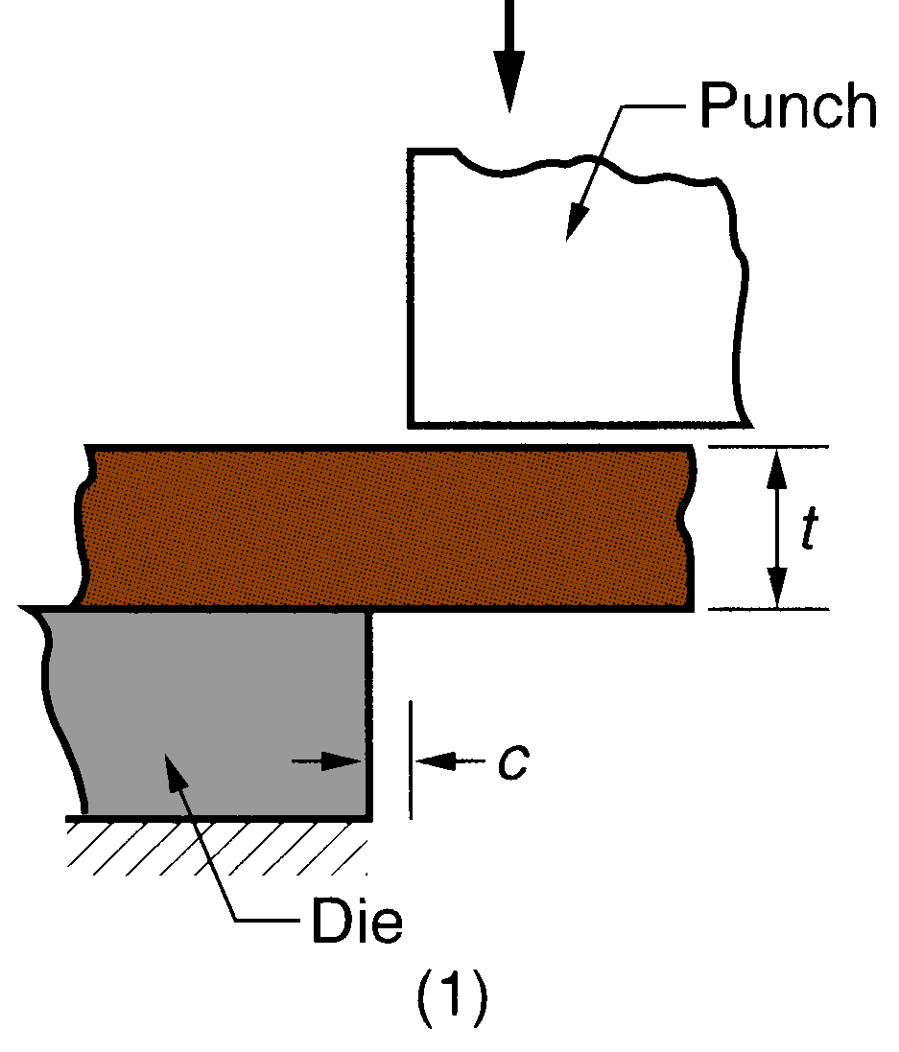
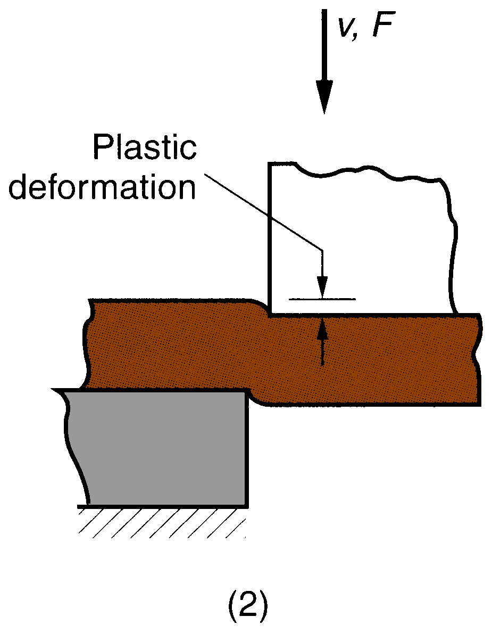
Sheet Metal Shearing
Shearing of sheet metal between two cutting edges: (1) just before the punch contacts work;
(2) punch begins to push into work, causing plastic deformation

Slide 9
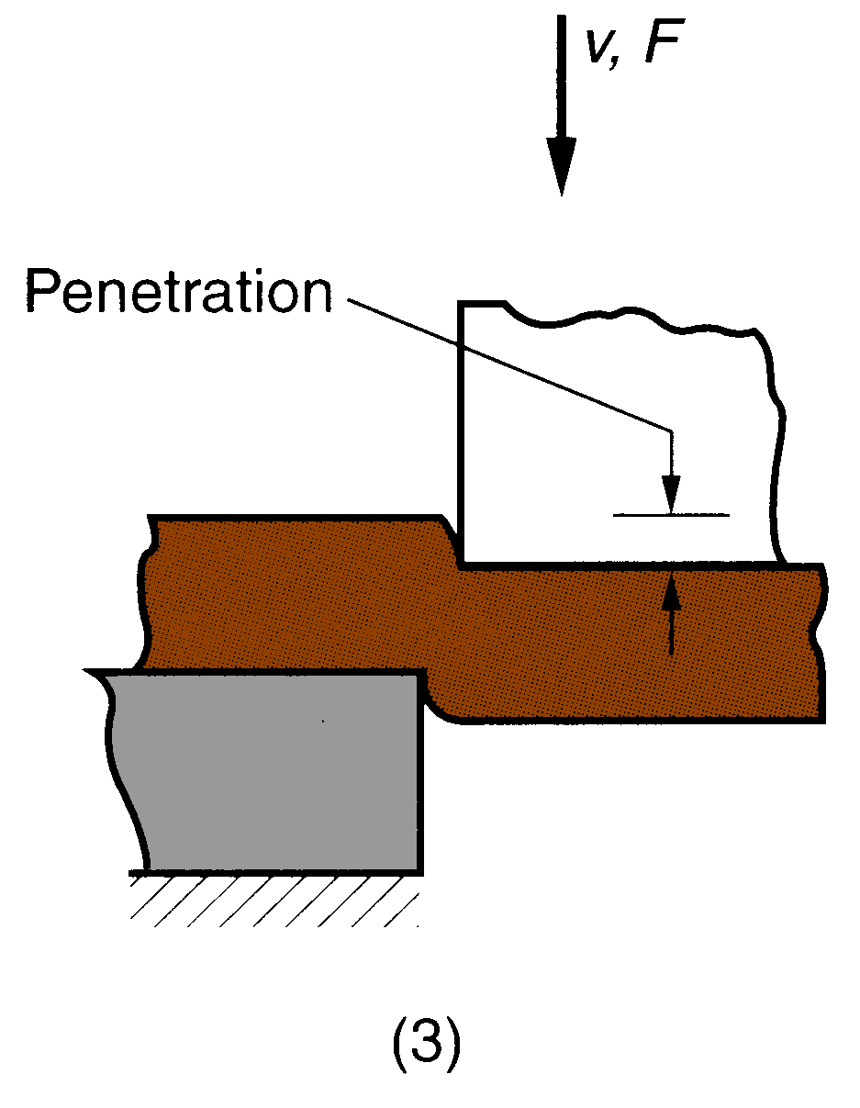
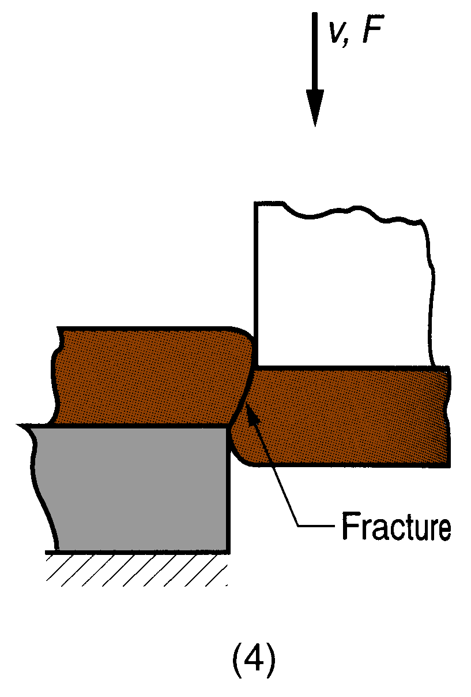
Sheet Metal Shearing
Shearing of sheet metal between two cutting edges: (3) punch compresses and penetrates into work causing a smooth cut surface;
(4) fracture is initiated at the opposing cutting edges which separates the sheet.

Slide 10
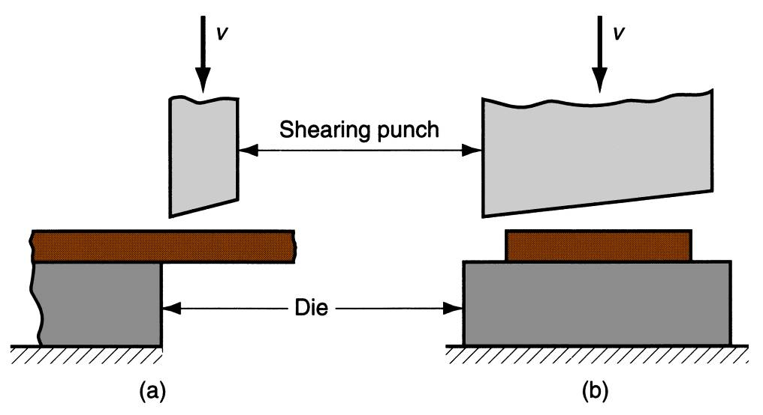
Sheet metal cutting operation along a straight line between two cutting edges
Typically used to cut large sheets
Shearing operation: (a) side view of the shearing operation; (b) front view of power shears equipped with inclined upper cutting blade.
Engagement of entire blade into cutting need higher forces. Therefore, inclined blade is used to reduce force and to improve cut- edge

Slide 11
Shearing
Shearing is a process for cutting sheet metal to size out of a larger stock such as roll stock.
Shears are used as the preliminary step in preparing stock for stamping processes, or smaller blanks for CNC presses
The shearing process produces a shear edge burr, which can be minimized to less than 10% of the material thickness.
The burr is a function of clearance between the punch and the die, and the sharpness of the punch and the die.

Slide 12
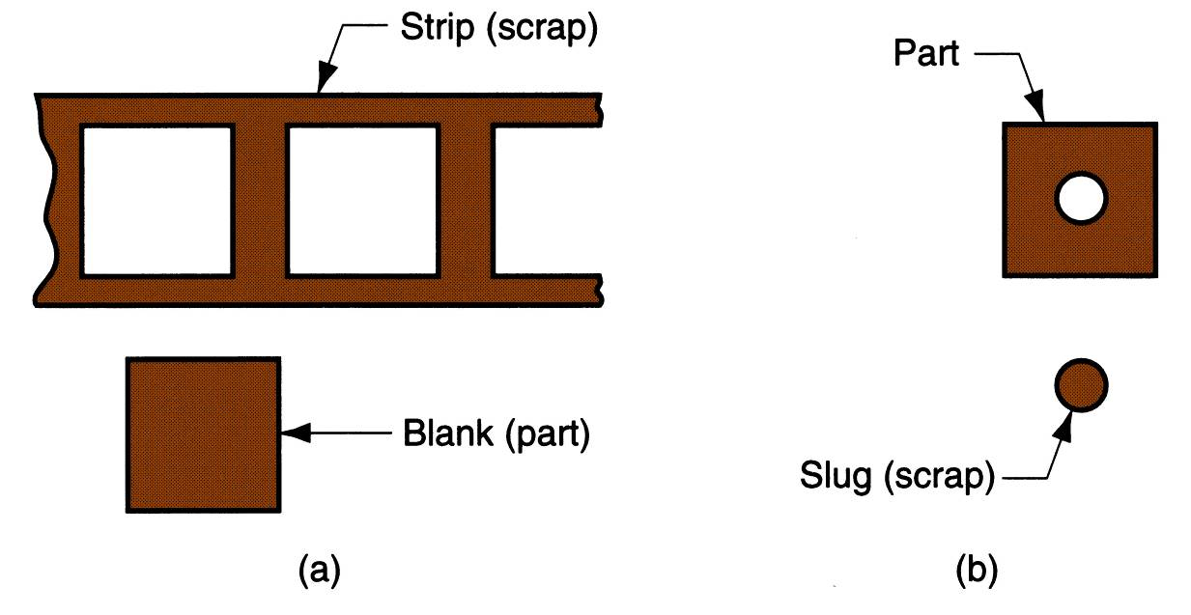
Blanking and Punching
Blanking - sheet metal cutting to separate piece (called a blank) from surrounding stock
Punching - similar to blanking except cut piece is scrap, called a slug
(a) Blanking and (b) punching.

Slide 13

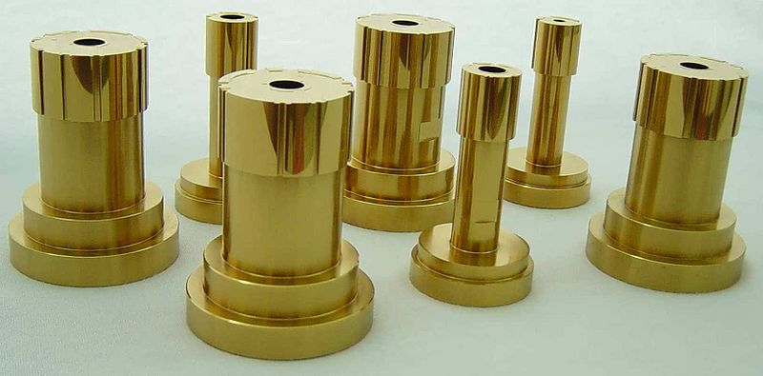
Punching and Piercing
Punching
Piercing
Slug is cut and bur is minimum
No slug is cut, only bur

Slide 14
Punching
Punching is a metal fabricating process that removes a scrap slug from the metal workpiece each time a punch enters the punching die. This process leaves a hole in the metal workpiece

Slide 15
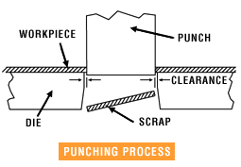
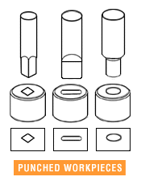
Punching Operation
Punching is a 1. Punch, made of hardened steel, is forced through a work-piece.
2. The punch cuts the metal and separates it in the form of scrap
3. The hole size depends on the punch size
Characteristics:
Ability to produce economical holes in both strip and sheet metal during medium or high production processes.
The ability to produce holes of varying shapes – quickly

Slide 16
Punch Tools

Slide 17
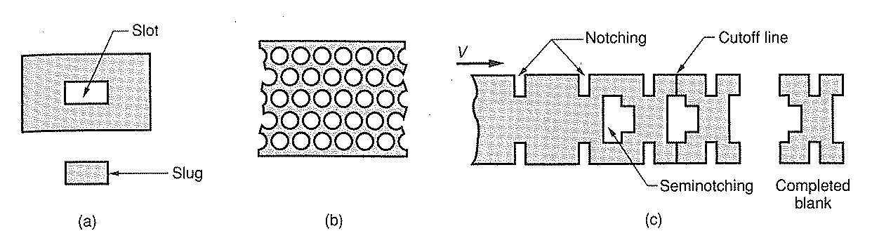
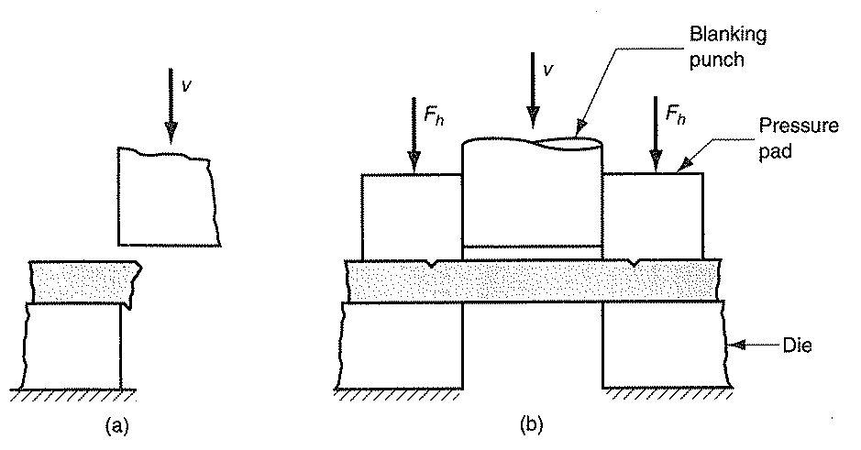

Slide 18
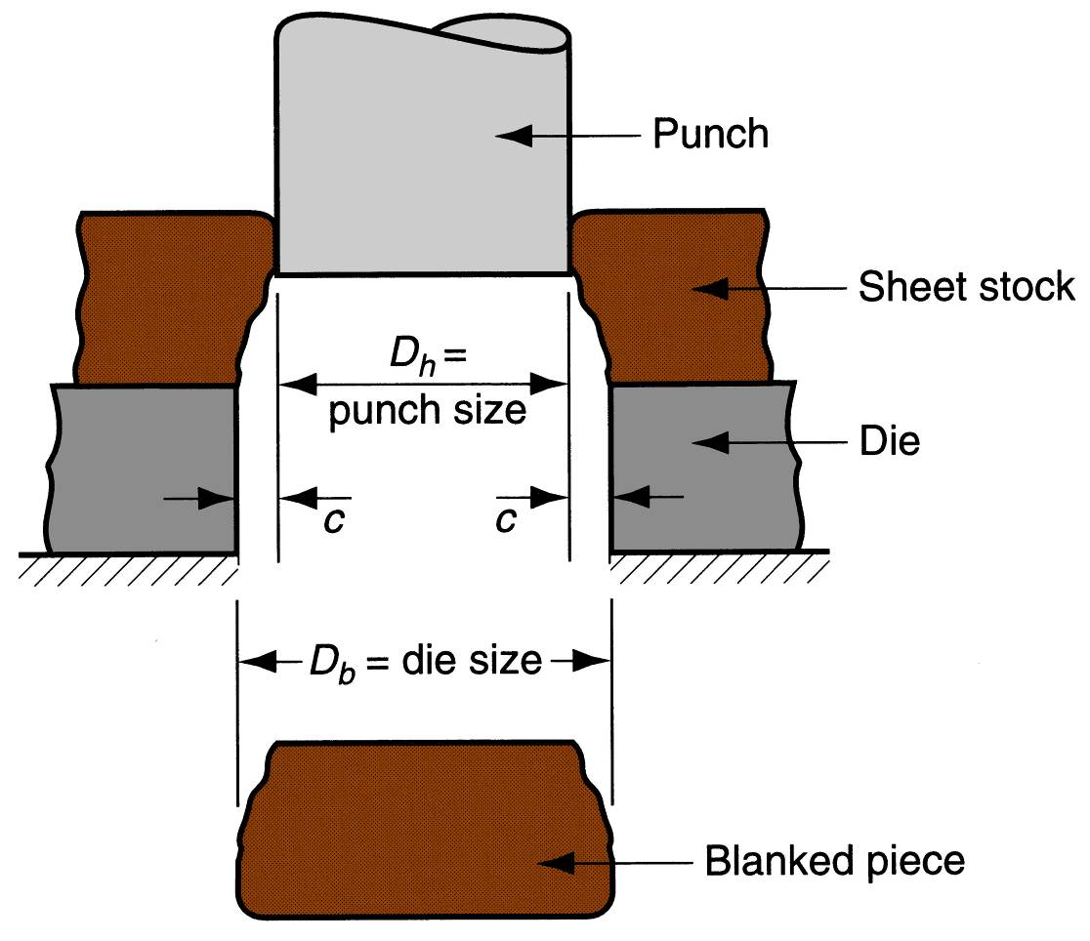
Punch and Die Sizes
Die size determines blank size D_{b};
Punch size determines hole size D_{h}.;
c = clearance

Slide 19
Clearance in Sheet metal Cutting
Distance between punch cutting edge and die cutting edge
Typical values range between 6% and 15% of stock thickness
  If clearance is too small, fracture lines pass each other, causing double buffing and larger force
  If too large, metal is pinched and bent between cutting edges and excessive burr results

Slide 20
Clearance in Sheet metal Cutting
Recommended clearance is calculated by:
c = at
where c = clearance; a = allowance; and t = stock thickness
Allowance a is determined according to type of metal
Low “c” for soft materials
High “c” for hard materials
Typical “a” values for metals range from 0.04 to 0.09

Slide 21
Punch and Die Sizes
  Blanking (Blank diameter is controlled)
- For a round blank of diameter, D_{b}
  Diameter of die = blank diameter ( D_{b})
  Diameter of punch = D_{b} - 2c
  where c = clearance
  Punching (Hole diameter is controlled)
- For a round hole of diameter , D_{h}
  Diameter of punch = hole diameter (D_{h} )
  Diameter of die = D_{h} + 2c
  where c = clearance

Slide 22
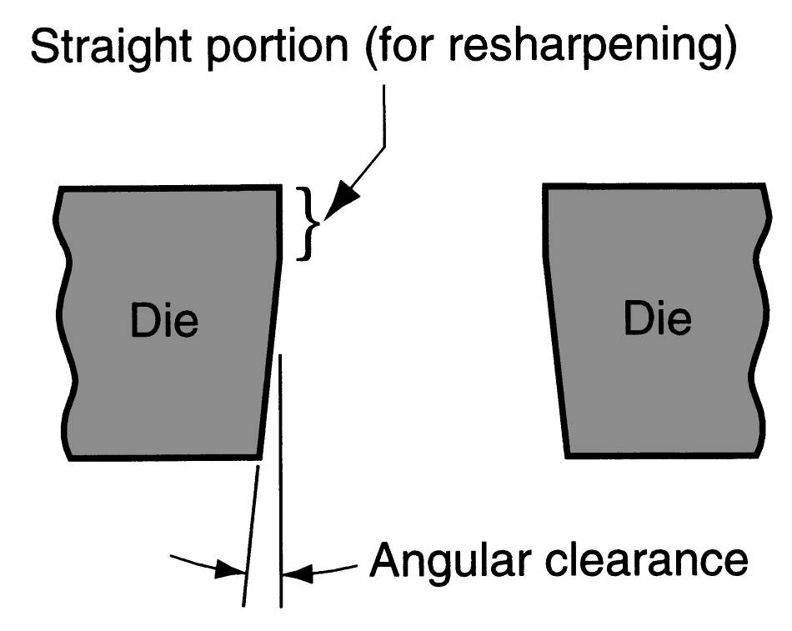
Angular Clearance
Purpose: allows slug or blank to drop through die
Typical values: 0.25° to 1.5° on each side

Slide 23
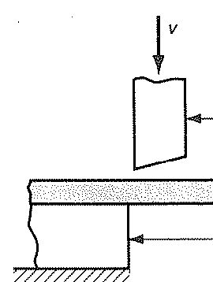
Cutting Forces
Important for determining press size (tonnage)
F = S t L
where S = shear strength of the metal; t = stock thickness,
L = length of cut edge (contact length) = 2*3.14* R
L is basically perimeter of blank or hole being cut
The above formula is based on fact that entire
punch face is engaged in cutting.
If angled punched is used, cutting force will
reduce.

Slide 24
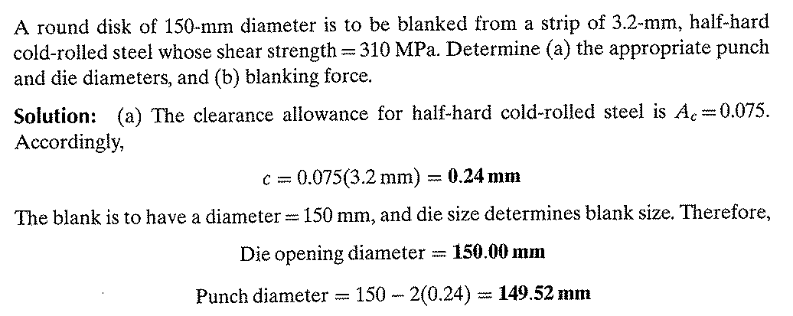

Slide 25
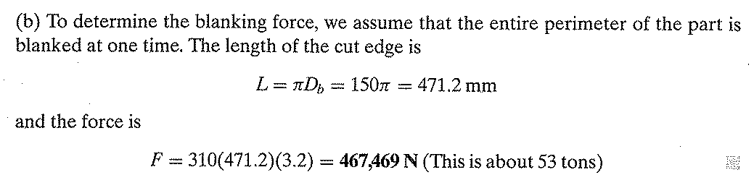

Slide 26
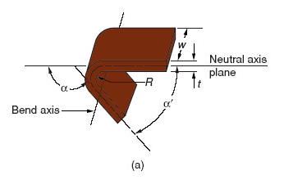
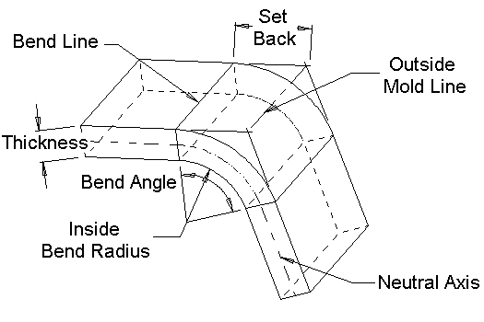
Sheet Metal Bending
Straining sheet metal around a straight axis to take a permanent bend

Slide 27
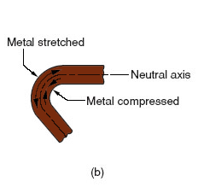
Sheet Metal Bending
Metal below the neutral axis is compressed, while metal above the neutral axis is stretched
Metal on neutral axis neither stretched nor compressed
The material is stressed beyond the yield strength but below the ultimate tensile strength.
The surface area of the material does not change much., why??
Bending usually refers to deformation about one axis

Slide 28
Types of Sheet Metal Bending
V‑bending - performed with a V‑shaped die
Edge bending - performed with a wiping die

Slide 29
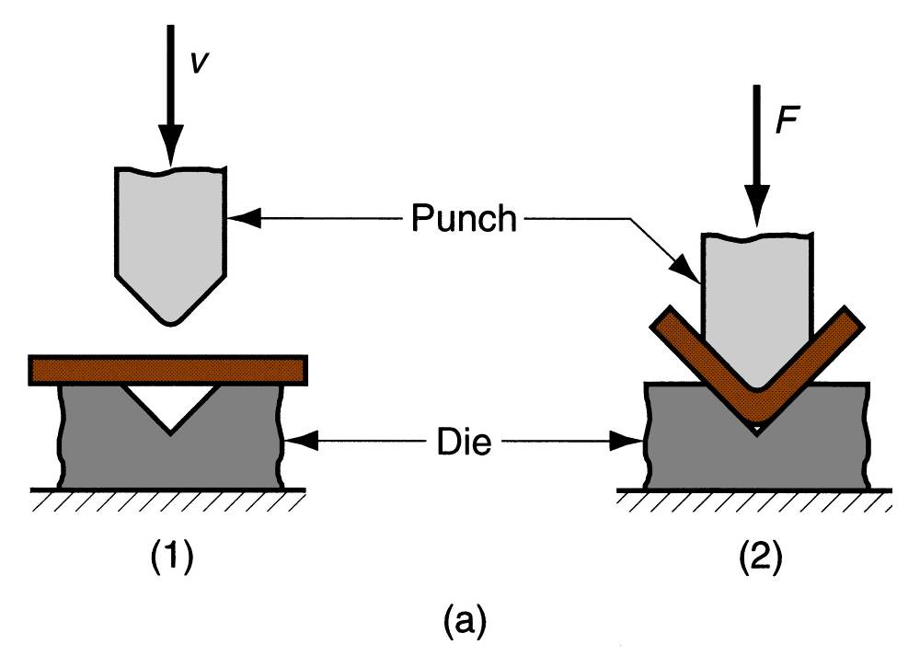
V bending
For low production
Performed on a brake press
V-dies are simple and inexpensive

Slide 30
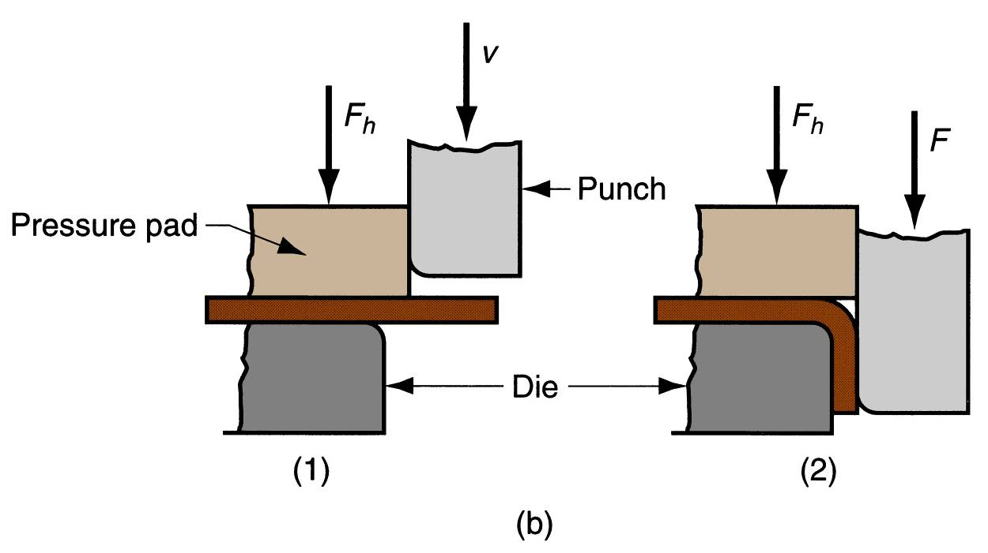
Edge bending
For high production
Pressure pad required
Dies are more complicated and costly

Slide 31
Stretching during Bending
If bend radius is small relative to stock thickness, metal tends to stretch during bending
Important to estimate amount of stretching, so that final part length can be obtained as specified dimension

Slide 32
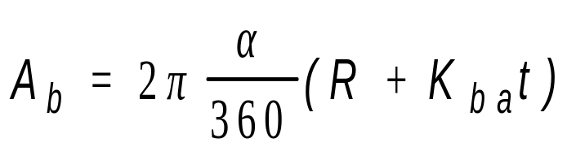
Bend Allowance Formula
where A_{b} = bend allowance; α = bend angle; R= bend radius; t = stock thickness; and K_{ba} is factor to estimate stretching
If R < 2t, K_{ba} = 0.33
If R ≥ 2t, K_{ba} = 0.50

Slide 33
Spring Back
Increase in included angle of bent part relative to included angle of forming tool after tool is removed
Reason for spring-back:
  When bending pressure is removed, elastic energy remains in bent part, causing it to recover partially toward its original shape

Slide 34
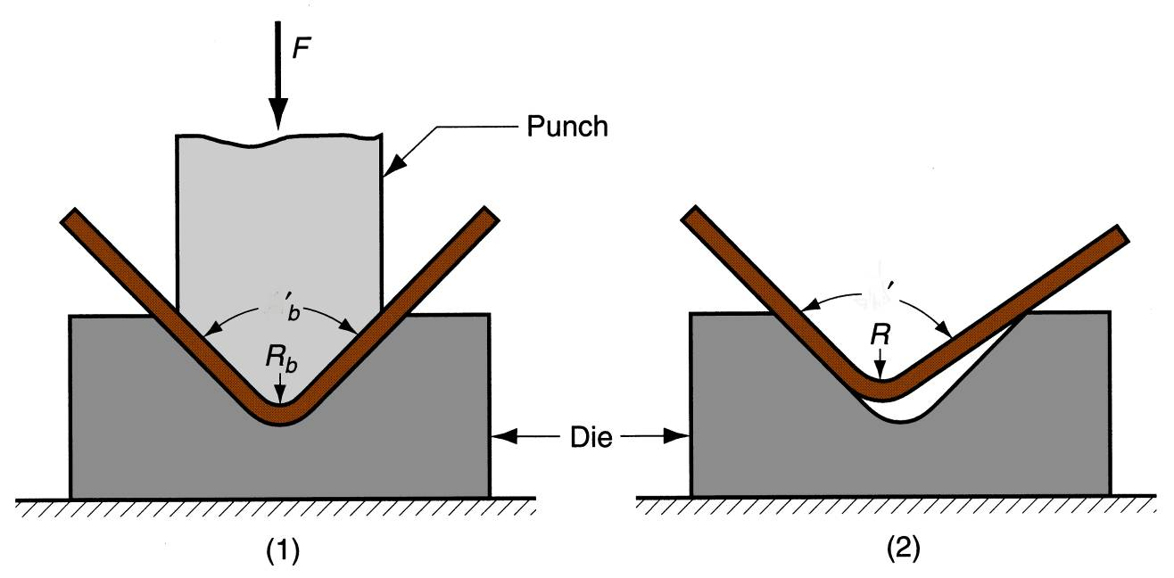
Spring Back (SB)
SB= (α’-α’b)/α’b
Springback in bending is seen as a decrease in bend angle and an increase in bend radius: (1) during bending, the work is forced to take radius R_{b} and included angle α_{b}' of the bending tool, (2) after punch is removed, the work springs back to radius R and angle α‘.

Slide 35
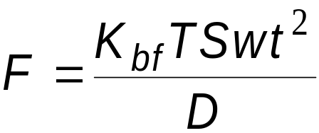
Bending Force
Maximum bending force estimated as follows:
where F = bending force; TS = tensile strength of sheet metal; w = part width in direction of bend axis; and t = stock thickness. For V- bending, K_{bf} = 1.33; for edge bending, K_{bf} = 0.33; D is opening width of a V-die or wiping die

Slide 36
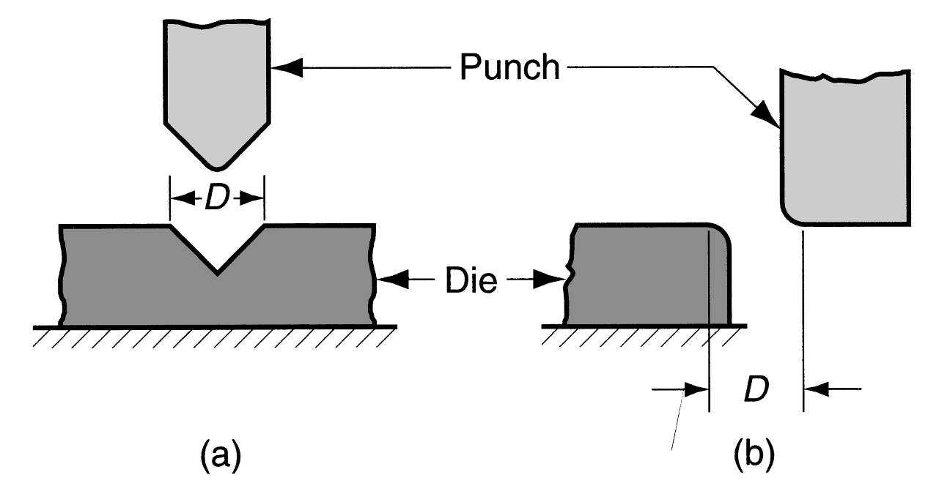
Die Opening Dimension
Die opening dimension D: (a) V‑die, (b) wiping die.

Slide 37
Drawing
Sheet metal forming to make cup‑shaped, box‑shaped, or other complex‑curved, hollow‑shaped parts
Sheet metal blank is positioned over die cavity and then punch pushes metal into opening
Products: beverage cans, ammunition shells, automobile body panels
Also known as deep drawing (to distinguish it from wire and bar drawing)

Slide 38
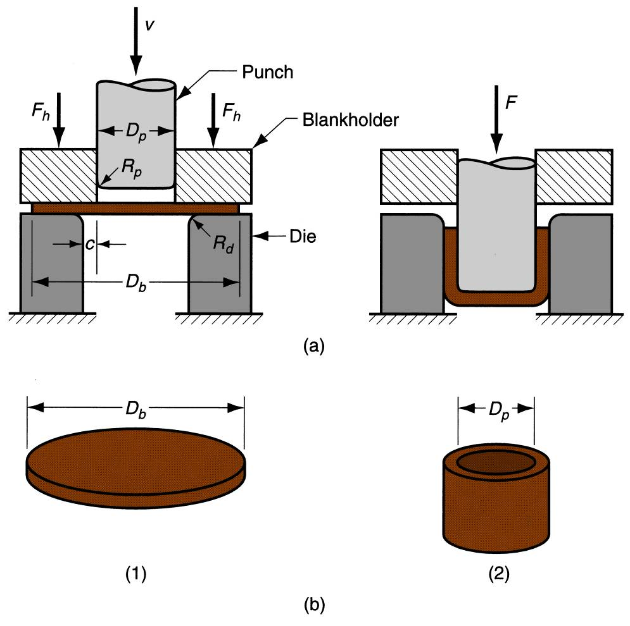
Drawing
Difference between wire drawing & deep drawing?
(a) Drawing of cup‑shaped part: (1) before punch contacts work, (2) near end of stroke; (b) work-part: (1) starting blank, (2) drawn part.

Slide 39
Clearance in Drawing
Sides of punch and die separated by a clearance c given by:
c = 1.1 t
where t = stock thickness
In other words, clearance is about 10% greater than stock thickness

Slide 40
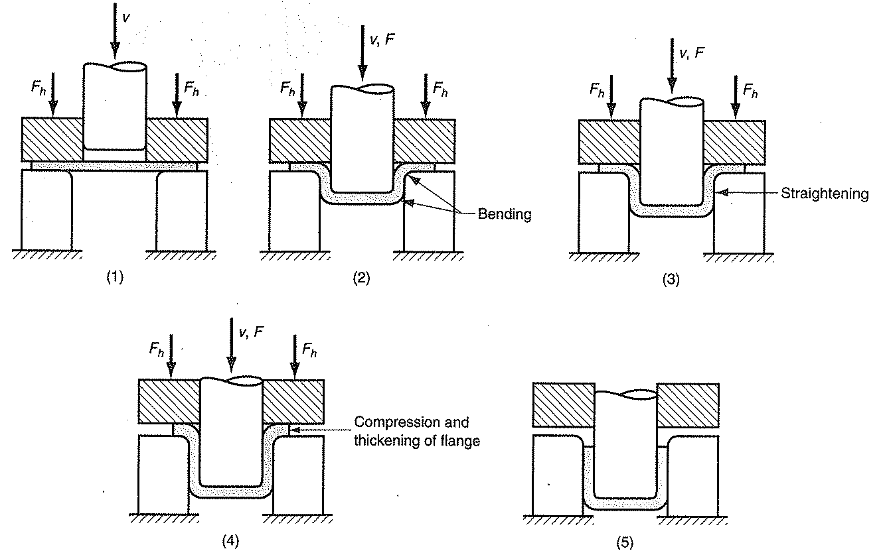
Mechanics of Drawing

Slide 41
Measures of Drawing Severity
Drawing Ratio: Db/Dp (Depends on Punch & Die corner radii, Friction conditions, Depth of draw and Material properties)
Optimal value: 2. Greater the ratio, more severer the operation
Reduction: r= (Db-Dp)/Db
Optimal value should be less than 2
Thickness/Blank Diameter: (to/Db): It should be greater than 1%. Lower ratios lead to wrinkling of flange.

Slide 42

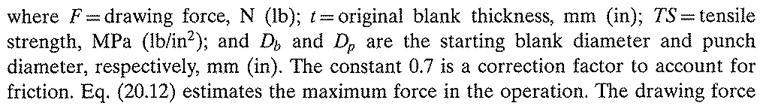

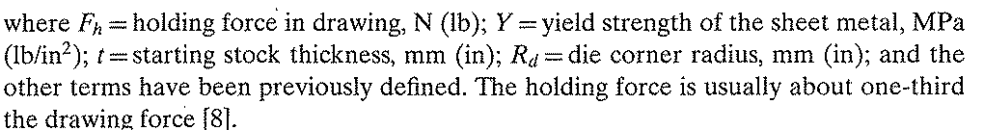
Forces in Sheet Drawing
Drawing force required by punch:
Blank holding force:
Higher holding forces don’t allow material to be be pulled into the die, causing undue stretching of blank and tearing.
Smaller holding forces cause wrinkling of flange

Slide 43
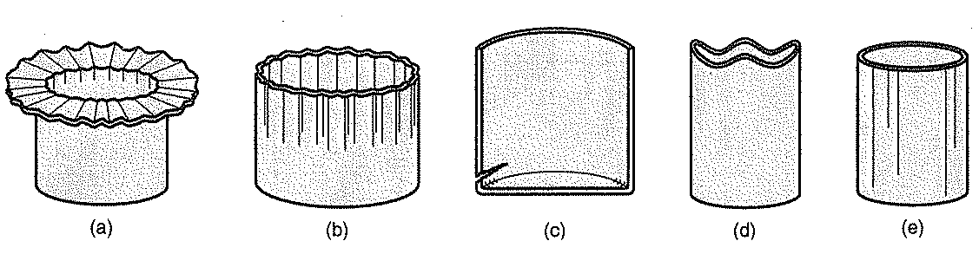
Defects in Sheet Drawing

Slide 44
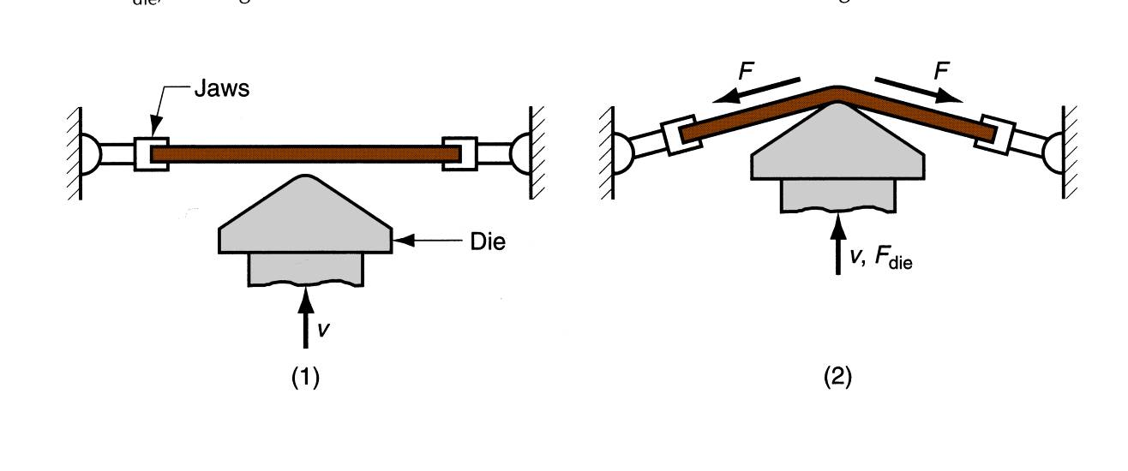
Stretch Forming
Sheet metal is stretched and simultaneously bent to achieve shape change
Stretch forming: (1) start of process; (2) form die is pressed into the work with force F_{die}, causing it to be stretched and bent over the form. F = stretching force.

Slide 45
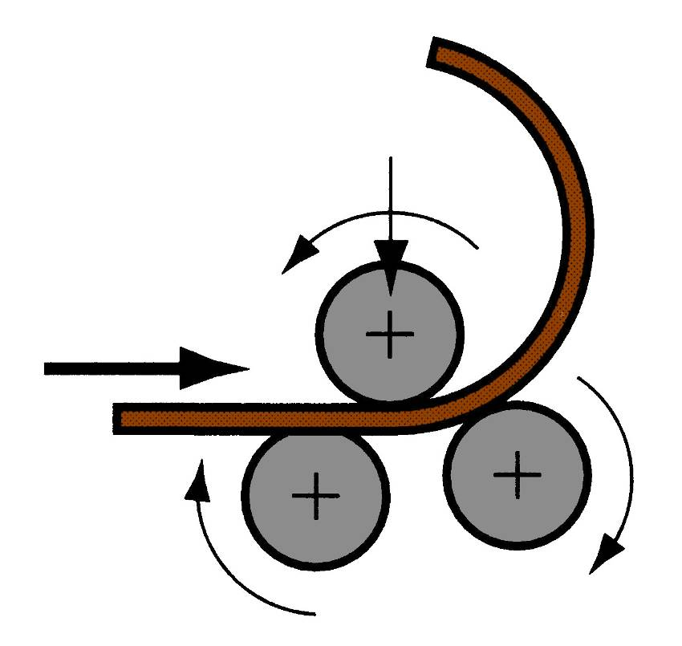
Roll Bending
Large metal sheets and plates are formed into curved sections using rolls
Plastic deformation but no significant material flow

Slide 46
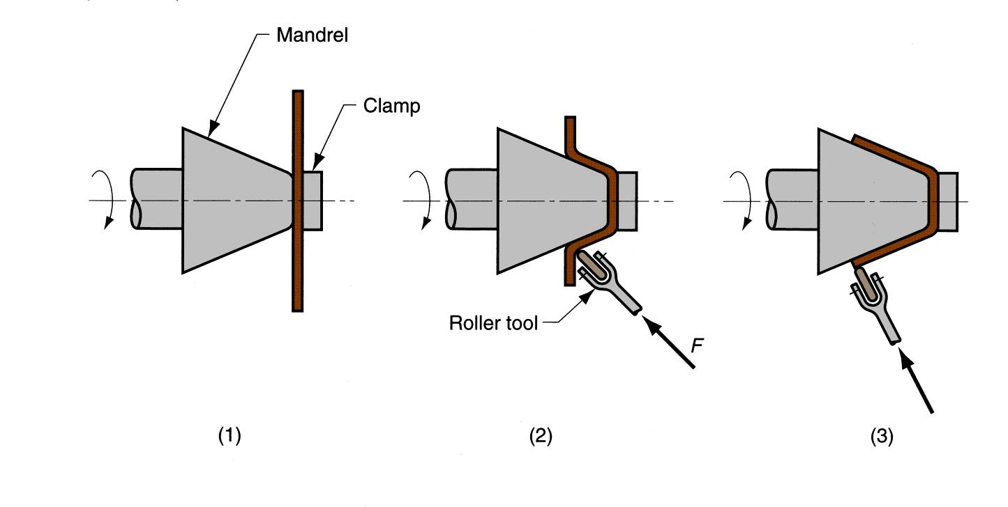
Spinning
Metal forming process in which an axially symmetric part is gradually shaped over a rotating mandrel using a rounded tool or roller
Products: Automobile parts, Utensils, Aerospace parts
Deformation is in local area
Conventional spinning: (1) setup at start of process; (2) during spinning; and (3) completion of process.

Slide 47
Types of Spinning
Three types:
  Conventional spinning
  Shear spinning
  Tube spinning

Slide 48
Conventional Spinning
Conventional spinning: (1) setup at start of process; (2) during spinning; and (3) completion of process.
1. Process is completed in several passes
2. Thinning occurs but not to great extent
3. Blank diameter reduces as process proceeds
4. Thin blanks are used

Slide 49

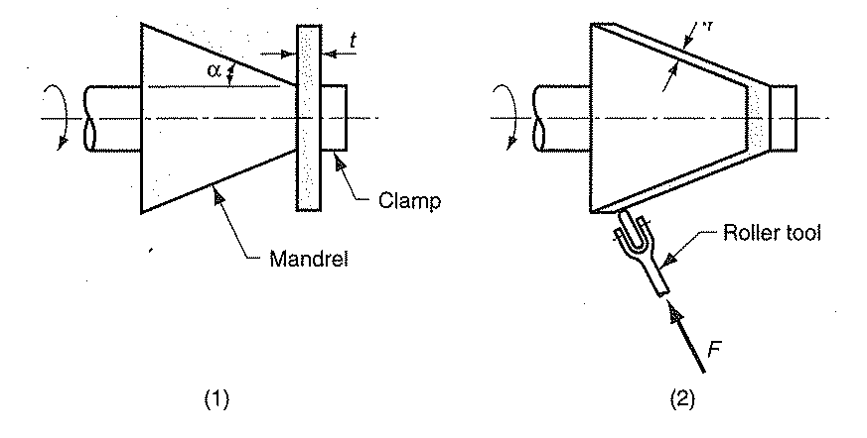

Shear Spinning
Deformation is performed through shearing of blank, parallel to rotation axis.
Final thickness is reduced extensively:
Thick blanks are used

Slide 50
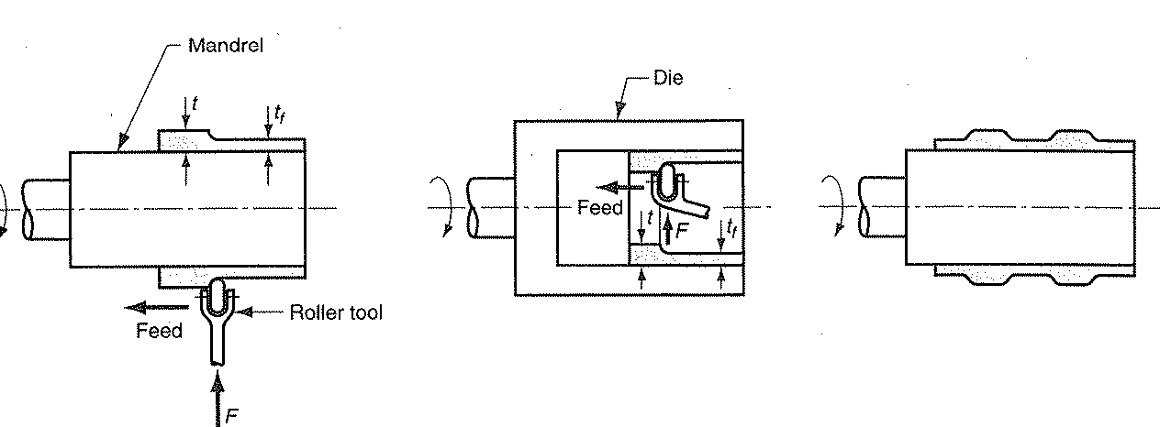
Tube Spinning
Tube spinning is used to produce tubes and cylinders
As the roller moves in axial direction, the thickness reduces and the length increases.
The roller touches the parts of the tubular blank, the deformation is local.

